Slide 1

Enhancing Operational Efficiency in a Multispecialty Hospital
Name: Petchiyammal R
Date: 5/10/2025

Slide 2
Table of Contents
Executive Summary
Introduction
Business Objectives
Methodology
Requirements Gathering (BRD and RTM)
Stakeholder Analysis and Engagement Plan
Scope Management Plan
Data Analysis
Data Visualization
Process Mapping
Risk Assessment Plan
Risk Mitigation Plan
Findings and Recommendations
Key Findings
Key Recommendations
Conclusion
Appendix

Slide 3
Executive Summary
Outline the problem, key insights, and recommended actions in 6 bullet points.
Problem:
1. Long patient wait times (average 47 minutes).
Key insights:
30% of patients experience delays over 45 minutes. Radiology and pharmacy are underutilized, while OPD and emergency are overused.
Overlapping staff roles contribute to inefficiency.
Recommended actions:
1.Implement a hospital-wide digital scheduling and patient flow system. 2. Optimize staff allocation and introduce self-check-in kiosks to reduce bottlenecks.

Slide 4
Introduction
Summarize the opportunity, describe the approach, and outline the key questions or hypotheses to be analyzed in 6 bullet points.
Opportunity:
1.
2.
Approach:
1. Collect and analyze patient flow, staff allocation, and resource usage data. 2. Apply process mapping and visualization tools to identify bottlenecks.
Key questions/hypotheses:
Will digital scheduling reduce patient wait times significantly?
Can optimized staff distribution and clear workflows improve efficiency and satisfaction?
Enhance patient care quality by reducing operational delays.
Improve hospital resource utilization and patient satisfaction.

Slide 5
Business Objectives
Areas of improvement in 6 bullet points:
1.Reduce patient wait times across outpatient and emergency departments.
2.Improve utilization of underused resources (e.g., radiology, pharmacy).
3.Streamline staff scheduling and eliminate overlapping roles.
Enhance inter-departmental communication and coordination.
4.Increase overall patient satisfaction and hospital service ratings.
5.Implement real-time performance monitoring through digital dashboards.

Slide 6

Methodology

Slide 7
Requirements Gathering: Business Requirement Document (BRD)
Problem statement:
At present, the hospital operates with outdated and disconnected systems. Doctors are frequently overbooked, and access to diagnostic equipment and operating rooms is often delayed. Nurses struggle with uneven staff-to-patient ratios and poor coordination during patient transfers. Administrative staff face difficulties with double bookings and outdated patient record systems, while IT teams highlight frequent downtimes and security concerns. Patients, in turn, experience delays, poor communication, and lack of clarity regarding appointments and next steps.
Key requirements to improve operational efficiency:
Doctors lose up to 40 minutes daily due to delays; nurses face burnout from poor coordination; 30% of patient complaints relate to scheduling; administrative staff report frequent double bookings; IT logs show multiple downtimes per month.

Slide 8
Requirements Gathering: Business Requirement Document (BRD)
Constraints:
Acceptance criteria:
Achieve at least a 20–25% reduction in patient wait times within 6 months.
Balanced resource utilization across departments.
≥80% patient satisfaction rate post-implementation.
Successful staff adoption of new workflows and digital tools.
Limited budget for large-scale IT upgrades.
Possible resistance to change among staff.
Compliance with healthcare regulations and patient data security.

Slide 9
Requirements Gathering: Requirement Traceability Matrix (RTM)
Requirement ID | Requirement Description | Priority (MoSCoW) | Stakeholder(s) | Project Objective | Related Data File | Status
Automate appointment scheduling system | Must Have | Patients, Admin Staff, Doctors | Reduce scheduling conflicts and wait times | appointment_data.csv | Proposed
Real-time diagnostic test result sharing | Must Have | Doctors, Nurses | Improve inter-departmental communication | feedback_data.csv | Proposed
Resource optimization and availability tracking | Must Have | Doctors, Nurses, Admin Staff | Ensure critical resources available during peak times | resource_data.csv | Proposed
Patient communication system with notifications (SMS/Email) | Should Have | Patients, Admin Staff | Enhance patient experience and reduce no-shows | feedback_data.csv | Proposed
Integrated Hospital Information System (HIS) | Must Have | IT Team, Admin Staff | Centralize patient and resource data for efficiency | appointment_data.csv, resource_data.csv | Proposed
System should be scalable to handle peak loads | Must Have | IT Team | Ensure performance under high demand | resource_data.csv | Proposed
System should comply with healthcare regulations (HIPAA) | Must Have | IT Manager, Admin Staff | Ensure data privacy and security | feedback_data.csv | Proposed
System should have 99.9% uptime availability | Should Have | IT Manager | Improve system reliability | resource_data.csv | Proposed
System should provide user-friendly interfaces | Should Have | Patients, Admin Staff | Improve usability for patients and staff | feedback_data.csv | Proposed

Slide 10
Stakeholder Analysis and Engagement Plan
Stakeholders:
Stakeholders’ influence:
Hospital Management (Board & Directors)
Department Heads (OPD, Radiology, Pharmacy, Emergency)
Medical Staff (Doctors, Nurses, Technicians)
Administrative Staff (Scheduling, Billing, Records)
Patients and Caregivers
IT & Operations Team
Hospital Management: High influence on budget approvals and policy changes.
Department Heads: Moderate-to-high influence on workflow redesign and staff allocation.
Medical Staff: High influence on adoption and success of new processes.
Administrative Staff: Moderate influence; key in implementing scheduling and reporting changes.
Patients & Caregivers: Indirect influence through feedback and satisfaction scores.
IT & Operations Team: High influence on technical feasibility and system integration

Slide 11
Stakeholder Analysis and Engagement Plan
Stakeholder engagement strategies:
Stakeholder communication strategies:
Hospital Management: Engage through strategic alignment workshops and ROI discussions.
Department Heads: Include in workflow redesign, pilot testing, and decision-making.
Medical Staff: Conduct regular training, encourage feedback, and provide recognition for adoption.
Administrative Staff: Offer hands-on tool demonstrations, clear role definitions, and continuous support.
Patients & Caregivers: Collect feedback via surveys, involve in awareness sessions, and ensure transparency.
IT & Operations Team: Collaborate in agile sprints, involve in technical design, and review integration checkpoints
Hospital Management: Monthly dashboards and executive summary reports.
Department Heads: Weekly coordination meetings and process update emails.
Medical Staff: Daily shift huddles, digital noticeboards, and quick reference guides.
Administrative Staff: Email circulars, SOP manuals, and helpdesk support.
Patients & Caregivers: SMS/email notifications, feedback forms, posters in common areas.
IT & Operations Team: Daily stand-up meetings, project management software updates, and technical documentation

Slide 12
Scope Management Plan
In-scope activities:
Out-of-scope activities:
Hospital Management: Regular progress reviews, ROI-focused presentations.
Department Heads: Involve in process mapping and pilot testing phases.
Medical Staff: Training workshops, feedback sessions, recognition programs.
Administrative Staff: Hands-on training for digital tools, clear SOPs.
Patients & Caregivers: Feedback surveys, awareness campaigns on new processes.
IT & Operations Team: Collaborative design sessions, agile implementation updates.
Hospital Management: Monthly executive reports and dashboards.
Department Heads: Weekly coordination meetings and workflow updates.
Medical Staff: Daily huddles and digital noticeboards.
Administrative Staff: Email circulars, training manuals, and helpline support.
Patients & Caregivers: SMS/email notifications, posters in waiting areas.
IT & Operations Team: Project management tools, daily stand-up calls.

Slide 13
Scope Management Plan
Assumptions:
Constraints:
Staff and management will cooperate.
Tools like Power BI or Excel are available.
Current hospital processes remain stable.
Recommendations are practical to implemenent
Hospital data is complete and accurate.
Limited project timeline.
Possible gaps or missing data.
Implementation of recommendations is out of scope.
Limited access to hospital staff for information.
No extra budget for new technology

Slide 14
Scope Management Plan
Phases in the Work Breakdown Structure (WBS):
WBS ID | Task Name | Task Description | Milestone
1.0 | Project Initiation | Define objectives, scope, and stakeholders | Project Charter Approved
2.0 | Data Collection | Gather patient, resource, and operational data | Data Collection Completed
3.0 | Data Analysis | Analyze workflows, patient flow, and resource utilization | Analysis Report Submitted
4.0 | Process Optimization Recommendations | Propose solutions to improve efficiency | Recommendations Approved
5.0 | Dashboard & Visualization | Create dashboards for real-time operational monitoring | Dashboard Developed
6.0 | Final Report & Presentation | Compile findings, insights, and recommendations into final report | Final Report Submitted / Presentation Delivered

Slide 15
Scope Management Plan
Scope change management:
All scope changes must be documented and justified.
Assess impact on timeline, resources, and deliverables.
Changes require approval from project mentor/instructor.
Update project plan and deliverables after approval.
Inform all stakeholders about approved changes.
Ensure changes align with project objectives.

Slide 16
Process Mapping
Process | As-Is Model | To-Be Model
Appointment Scheduling | Manual entry, double-booking, late notifications | Automated scheduling with conflict detection and instant alerts
Patient Check-In | Manual paperwork and long waits | Self-service digital check-in reduces wait times
Interdepartmental Communication | Manual communication, slow updates | Centralized dashboard with real-time alerts and tracking

Slide 17
Advanced Process Mapping
Detailed workflow using the advanced BPMN model:
Hospital Process Improvements
Appointment Scheduling
Current: Manual entry, double-booking, late notifications
Solution: Automated scheduling with conflict detection and instant alerts
Patient Check-In
Current: Manual paperwork, long waits
Solution: Self-service digital check-in to reduce wait times
Interdepartmental Communication
Current: Manual, slow updates
Solution: Centralized dashboard with real-time alerts
Workflow Visualization
Use BPMN model to map processes, decision points, and data flow
Helps optimize hospital operations efficiently

Slide 18
Advanced Process Mapping
Stakeholder responsibility using the Swimlane diagram:
Swimlane (Stakeholders) | Task/Activity | Description
Reception / Front Desk | Patient Registration | Register new patients and maintain accurate records.
Reception / Front Desk | Appointment Scheduling | Schedule patient appointments and avoid double-booking.
Reception / Front Desk | Patient Check-In | Manage check-in process and reduce waiting time.
Doctors / Medical Staff | Consultations & Diagnosis | Provide medical consultations and diagnose conditions.
Doctors / Medical Staff | Treatment & Follow-Up | Administer treatment and monitor patient progress.
Lab / Diagnostics | Conduct Tests | Perform lab and diagnostic tests accurately.
Lab / Diagnostics | Report Results | Update test results promptly to patient and system.
Administration / Management | Monitor KPIs | Track hospital operational metrics and efficiency.
Administration / Management | Allocate Resources | Manage staff, beds, and equipment allocation.
IT / Support Team | Maintain Digital Systems | Ensure smooth functioning of dashboards and automated alerts.
IT / Support Team | Support Automated Processes | Provide technical support for digital scheduling, check-in, and reporting systems.

Slide 19
Data Analysis
Trends using a Pivot Table:
Analyze patient flow, resource usage, and staff performance.
Organize data with Rows (Departments/Patient Types) and Columns (Time: days/weeks/months).
Use Values for metrics: patient count, waiting time, resource utilization.
Apply filters to focus on specific departments or time periods.
Identify patterns: peak hours, underutilized resources, bottlenecks.
Supports data-driven decisions for scheduling and resource allocation.

Slide 20
Data Analysis
Trends analyzed from the Pivot Table:
Peak Patient Hours: Most patients visit between 10 AM – 2 PM.
Department Load: Outpatient and diagnostics departments have the highest traffic.
Staff Utilization: Certain shifts are underutilized while others are overloaded.
Appointment Patterns: Mondays and Fridays see higher appointments than midweek.
Waiting Time Trends: Longer waiting times during peak periods; minimal delays during off-peak.
Resource Usage: Some medical equipment remains idle during off-peak hours.

Slide 21
Data Analysis
Key insights:
Patient Flow: Peak hours cause long waiting times; off-peak periods are underutilized.
Resource Utilization: Some staff and equipment are overworked, others remain idle.
Appointment Scheduling: Manual scheduling leads to double-booking and inefficiencies.
Interdepartmental Communication: Lack of centralized information causes delays.
Workflow Bottlenecks: Redundant paperwork and slow handoffs affect patient experience.
Technology Impact: Automated systems and dashboards can significantly improve efficiency.

Slide 22
Data Visualization
Average patient wait time using a horizontal bar chart:

Slide 23
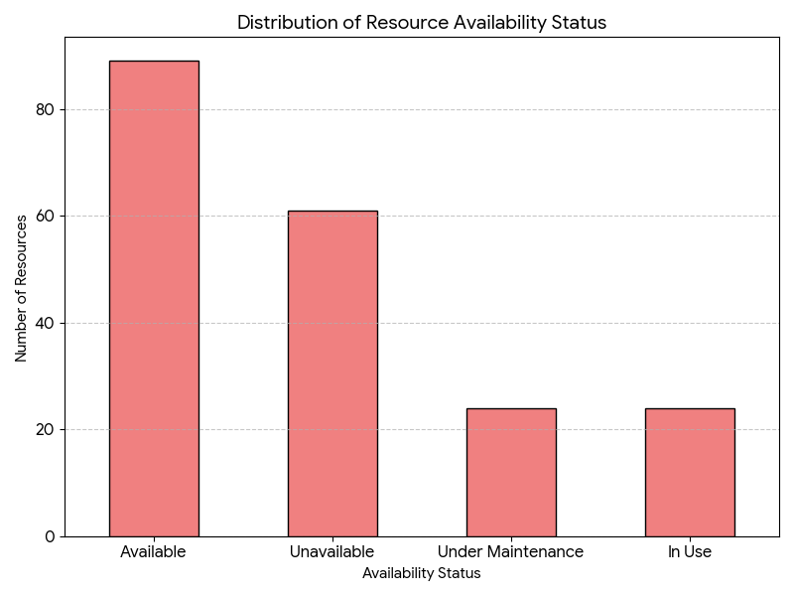
Data Visualization
Bar chart highlighting overused and underutilized resources:

Slide 24
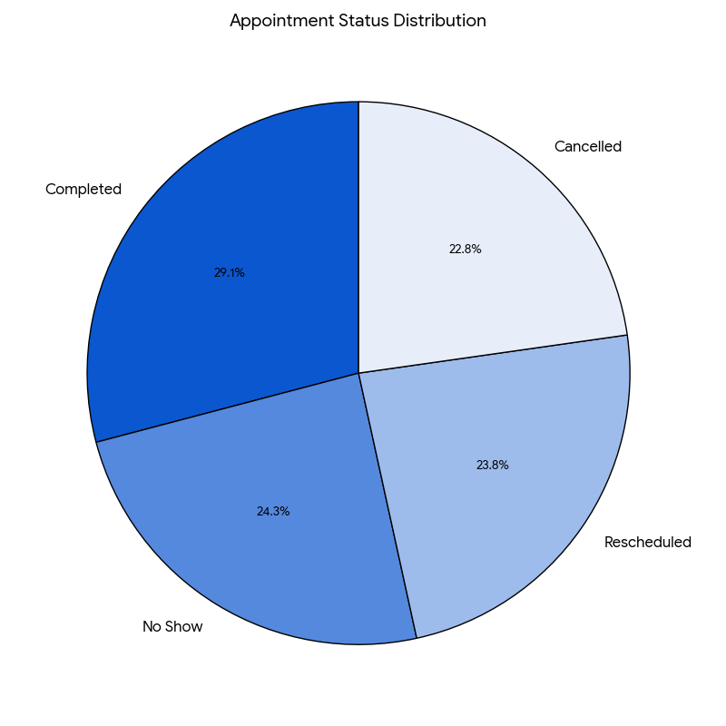
Data Visualization
Patient feedback visualized using a Pie Chart:

Slide 25
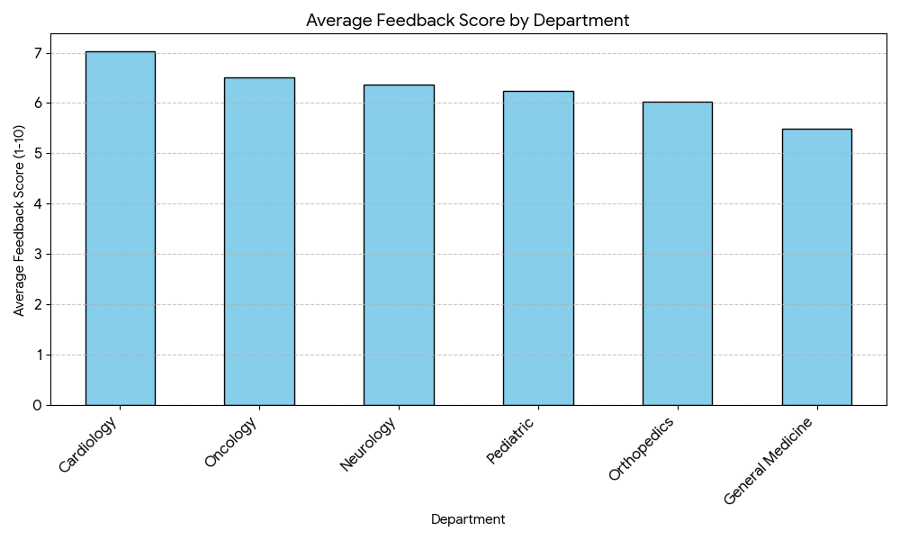
Data Visualization
Heat Map showing the efficiency of departments:

Slide 26
Risk Management Plan
Risks identified in the risk register:
Risk Description | Category | Mitigation Strategy | Likelihood | Impact | Severity | Mitigation Strategy
Data Inaccuracy | Operational / High | Regular data validation, maintain backup datasets.
Staff Unavailability | Human Resource / High | Cross-train staff, schedule backup personnel.
Technology Downtime | Technical / Medium | Backup systems, regular maintenance during off-peak hours.
Workflow Bottlenecks | Operational / Medium | Streamline processes, implement automation where possible.
Limited Budget | Financial / Low | Prioritize cost-effective solutions, phased implementation plan.
Minor Process Changes | Operational / Low | Monitor changes, update training and documentation.

Slide 27
Risk Management Plan
Risks categorized based on the Risk Assessment Matrix:
Likelihood \ Impact | Low Impact | Medium Impact | High Impact
Low Likelihood | R6 – Minor Process Changes | R5 – Limited Budget
Medium Likelihood |  | R4 – Workflow Bottlenecks | R3 – Technology Downtime
High Likelihood |  |  | R1 – Data Inaccuracy, R2 – Staff Unavailability

Slide 28
Risk Management Plan
Elements identified in the SWOT analysis:
Strengths
Weaknesses
Experienced medical and administrative staff
Existing hospital infrastructure and technology
Strong reputation and patient trust
Manual scheduling and check-in processes
Communication gaps between departments
Limited real-time operational data
Opportunities
Threats
Implement automation and digital dashboards
Optimize resource allocation and workflow
Predictive analytics to improve patient experience
System downtime or technology failures
Staff shortages or high turnover
Regulatory and compliance challenges

Slide 29
Risk Management Plan
Key insights from the Risk Management Plan:
High-Risk Areas Identified: Data accuracy, staff availability, and system downtime are critical.
Prioritization Matters: Risks are ranked based on likelihood and impact to focus mitigation efforts effectively.
Proactive Mitigation: Contingency plans and strategies reduce potential operational disruptions.
Resource Planning: Cross-training staff and maintaining backups improve resilience.
Continuous Monitoring: Regular tracking of risks ensures timely response and minimal impact.
Improved Decision-Making: Risk insights guide operational and strategic decisions for the hospital

Slide 30
Risk Mitigation Plan
Strategies to mitigate risks:
Category / Risk | Likelihood | Impact | Mitigation Strategy | Impact | Severity | Mitigation Strategy
Data Inaccuracy | High | High | Regular data validation, maintain backup datasets.
Staff Unavailability | Medium | High | Cross-train staff, schedule backup personnel.
Technology Downtime | Medium | Medium | Backup systems, regular maintenance during off-peak hours.
Workflow Bottlenecks | Medium | Medium | Streamline processes, implement automation where possible.
Limited Budget | Low | Medium | Prioritize cost-effective solutions, phased implementation plan.
Minor Process Changes | Low | Low | Monitor changes, update training and documentation.

Slide 31
Risk Mitigation Plan
Factors included in the Contingency Plan:
Risk ID | Factors / Risks | Contingency Plan
R1 | Data Inaccuracy | Perform regular data validation; maintain backup datasets.
R2 | Staff Unavailability | Cross-train staff; schedule backup personnel for critical tasks.
R3 | Technology Downtime | Use backup systems; schedule maintenance during off-peak hours.
R4 | Workflow Bottlenecks | Implement process automation; review and streamline workflows.
R5 | Limited Budget | Prioritize cost-effective solutions; phased implementation plan.
R6 | Minor Process Changes | Monitor changes; update documentation and training materials.

Slide 32
Risk Mitigation Plan
Risks prioritized based on the Visual Risk Matrix:
Priority Level | Risk ID & Description | Rationale | Action Urgency
High | R1 – Data Inaccuracy | Incorrect data affects analysis and decisions | Immediate
High | R2 – Staff Unavailability | Lack of staff input delays project milestones | Immediate
Medium | R3 – Technology Downtime | System failure can temporarily halt operations | Within 1 week
Medium | R4 – Workflow Bottlenecks | Redundant steps slow patient processing | Within 1 week
Low | R5 – Limited Budget | May restrict implementation of recommendations | Monitor & plan
Low | R6 – Minor Process Changes | Small variations unlikely to impact project scope | Monitor

Slide 33
Risk Mitigation Plan
Key insights from the Risk Mitigation Plan:
Data Accuracy Risk: Ensuring accurate and complete hospital data is crucial for reliable analysis.
Staff Cooperation Risk: Engaging hospital staff early reduces delays and enhances information sharing.
Technology Risk: System downtime or lack of digital tools can hinder process automation.
Implementation Risk: Recommendations need to be feasible within hospital policies and resource constraints.
Timeline Risk: Strict adherence to project schedule is necessary to meet Capstone deadlines.
Continuous Monitoring: Regular tracking and feedback loops help mitigate operational risks effectively.

Slide 34
Findings and Recommendations

Slide 35
Key Findings
Peak patient admission times lead to long waiting periods in outpatient and diagnostic departments.
Certain departments (e.g., radiology, lab) experience congestion due to uneven resource allocation.
Resource Utilization Gaps
Some medical equipment and staff are underutilized during off-peak hours.
Beds in specific wards remain idle while other areas face over-occupancy.
Inefficient Appointment and Scheduling System
Manual or semi-manual scheduling contributes to overlapping appointments and patient delays.
Predictive analysis shows potential to reduce waiting time by better aligning staff shifts and patient appointments.
Workflow Inefficiencies Across Departments
Redundant documentation and handoffs slow down patient processing.
Lack of integration between departments causes delays in lab tests and patient reporting.
Potential for Technology-Driven Improvements
Electronic dashboards and real-time data tracking can enhance operational decision-making.
AI and predictive analytics can optimize resource allocation and scheduling.

Slide 36
Key Recommendations
Implement Data-Driven Decision Making
Integrate a hospital-wide data analytics system to track patient flow, resource utilization, and staff performance.
Use dashboards (e.g., Power BI, Tableau) to provide real-time insights to management for operational decisions.
Optimize Patient Scheduling and Appointment Management
Introduce predictive models to forecast patient arrivals and peak times.
Implement an automated appointment scheduling system to reduce waiting times and avoid overbooking.
Streamline Resource Allocation
Analyze usage patterns for medical equipment, beds, and staff shifts.
Reallocate resources dynamically to high-demand areas to minimize bottlenecks and idle time.
Enhance Staff Productivity and Workflow
Map key hospital processes (e.g., patient admission, lab tests, discharge) and identify inefficiencies.
Adopt lean principles or Six Sigma methodologies to reduce redundant tasks and improve workflow.
Implement Electronic Health Records (EHR) Analytics
Leverage EHR data to identify trends in patient care, readmission rates, and treatment effectiveness.
Use predictive analytics for proactive patient care and operational planning.

Slide 37
Conclusion
Provide a summary of observations in 3–5 bullet points.
Patient wait times are a major bottleneck affecting both efficiency and satisfaction.
Resource utilization is imbalanced, with some departments overburdened while others remain underused.
Staff scheduling and workflow overlap contribute to operational inefficiencies.
Digital tools and real-time dashboards show strong potential to enhance decision-making.
Engaging stakeholders at every level is critical for successful adoption of improvements.

Slide 38


Slide 39
Appendix
Note: Use this section to include supplementary materials, such as charts, graphs, data tables, and other supporting documents, for this Business Analysis (BA) report.

